Slide 1

ALARM CLOCK
PROJECT SYNOPSIS
OF MINI PROJECT
BACHELOR OF TECHNOLOGY
COMPUTER SCIENCE AND ENGINEERING
SUBMITEED BY GUIDED
ANURAG SRIVASTAVA MS.ALKA SINGH
1905080100022 (Assistant professor)
CS21 BABU BANARSI DAS ENGINEERING COLLEGE
2nd year LUCKNOW
2019-2023

Slide 2
INTODUCTION
PROJECT: ALARM CLOCK
TECHNOLOGY:PYTHON
1.Alarm clock is a clock that is designed to alert an individual or group of individual at a specified time.
2. The primary function of these clocks is to awaken people from their night’s sleep or short naps; are sometimes used for other remainder as well.
3.With jobs ,college and other responsibilities, waking up by a set time remain a must for the majority of us .
4.Alarm clocks can also be helpful for keeping sleep schedules regular.
5.Using an alarm clock can help keep your schedule consistent and normalize your sleep patterns.
6.Alarm in technology are of two type :
-computer alarm .
-Mobile phone alarms.

Slide 3
Computer Alarm-alarm clock software programs have been developed by personal computers. There are web-based alarm clock some of which may allow a virtually unlimited number of alarm times (i.e personal information manager) and personalized tones.However unlike mobile phone alarms they have some limitations.They do not work when the computer is shut off or in sleep mode.
Mobile Phone Alarms -many modern mobile phone feature built-in alarm clock need do not need the phone to be switched on for the alarm to ring off.Some of these mobile phones features the ability for the user to set the alarm’s ringtone ,and in some cases music can be download to the phone and then chosen to play for waking.

Slide 4
OBJECTIVE OF PROJECT
1.The objective of this project is to implement an alarm clock using python .
2.Python consist of very useful libraries such as datetime and tkinter which help us to build project using the current date and time
3.Python also provide a user interface to set the alarm according to the requirement
in 24-hour format.
4.We use the popular GUI library for rendering graphics on a display
window.
5. Designing an easy-to-use clock interface.
6.Creating a alarm clock that would appeal to many user.

Slide 5
7.The objective of our project is to implement all the basic functions of the digital alarm clock which we find in our daily life routine .The features like 24 hours display ,clock ,clock setting ,alarm setting,alarm alert indicator.
8.This project requires good knoledge of python and GUI .Python when combined with Tkinter provides a fast and easy way to create GUI application .
9.Tkinter provides a powerful object –oriented interface to the Tk GUI toolkit.
10.All the modules used need not be download beforehand like the other libraries like NumPy,thus this project will be user friendly and accessible in any virtual enviornment used for python programming.

Slide 6
LITERATURE REVIEW
An alarm clock is a clock that is designed to alert an individual or group of individuals at a specified time .The primary function of these clocks is to aweken people from their night’s sleep or short naps ; they are sometimes used for other reminders as well . Most use sound ;some use light or vibration .some have sensors to identify when a person is in a light stage of sleep ,in order to avoid waking someone who is deeply asleep,which causes tirdness,even if the person has had adequate sleep.To turn off the sound or light ,a button or handle on the clock is pressed;most clock automatically turn off the alarm if unattended long enough .A classic digital alarm clock has an extra hand or inset dial that is used to specify the time at which the alarm will ring . Alarm clock are also used in mobile phones ,watches and computers

Slide 7
FUTURE SCOPE
Scientific studies on sleep having shown that awakening is an important factor in implifying sleep inertia. Alarm clock involve sleep stage monitering. Sleepers can become accustomed to the sound of their alarm clock if it has been used for a period of time ,making it less effective.Due to prograssive alarm clocks complex waking procedure ,they can deter this adaption due to the body needing to adapt to more stimuli than just a simple sound alert .time switches can be used to turn on anything that will awaken a sleeper, and can therefore be used as alarms.
In upcomig generation alarm clock plays a vital role to alert an individul . Alarm clock can also be helpful for keeping sleep schedules regular.
Using an alarm clock can help keep your shedules consistent and normalize your sleep pattern,

Slide 8
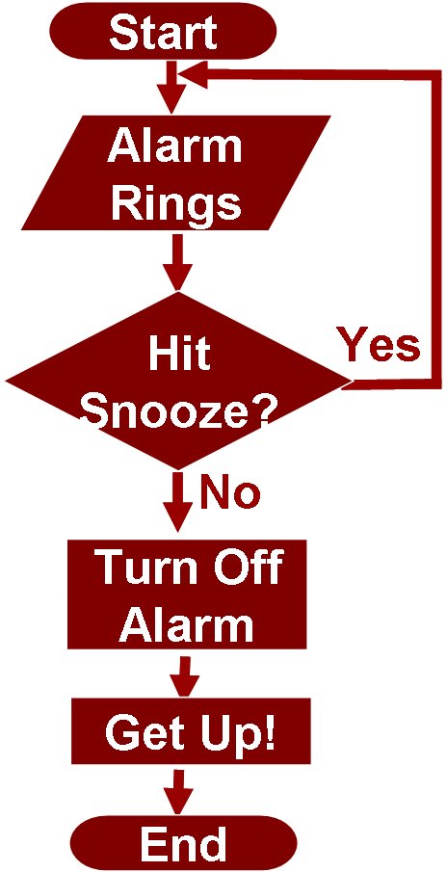
Flowchart

Slide 9
Project work completed
1. A progressive alarm clock can have different alarm for different times and play music of the users choice .
2. A classic alarm clock has an extra hand or inset dial that is used to specify the time at which the alarm will ring.
3. Alarm clocks are also used in mobile phones ,watches and computers
4. This alarm clock set multiple alarm .
5.With this project in python ,we have successfully made the Alarm clock.we used the popular GUI library for rendering graphics on a display window . We learned how extract the current time from computer and to use it for manipulation using the DateTime library.
6.This way we can set an alarm in the computer interface using python programming which rings with the default machine sound for window.

Slide 10
SOURCE CODE
#Importing all the necessary libraries to form the alarm clock:
from tkinter import *
import datetime
import time
import winsound
def alarm(set_alarm_timer):
while True:
time.sleep(1)
current_time = datetime.datetime.now()
now = current_time.strftime("%H:%M:%S")
date = current_time.strftime("%d/%m/%Y")

Slide 11
print("The Set Date is:",date)
print(now)
if now == set_alarm_timer:
print("Time to Wake up")
winsound.PlaySound("sound.mp3",winsound.SND_ASYNC)
break
def actual_time():
set_alarm_timer = f"{hour.get()}:{min.get()}:{sec.get()}"
alarm(set_alarm_timer)
clock = Tk()
clock.title("DataFlair Alarm Clock")
clock.geometry("400x200")

Slide 12
time_format=Label(clock, text= "Enter time in 24 hour format!", fg="red",bg="black",font="Arial").place(x=60,y=120)
addTime = Label(clock,text = "Hour Min Sec",font=60).place(x = 110)
setYourAlarm = Label(clock,text = "When to wake you up",fg="blue",relief = "solid",font=("Helevetica",7,"bold")).place(x=0, y=29)
# The Variables we require to set the alarm(initialization):
hour = StringVar()
min = StringVar()
sec = StringVar()

Slide 13
#Time required to set the alarm clock:
hourTime= Entry(clock,textvariable = hour,bg = "pink",width = 15).place(x=110,y=30)
minTime= Entry(clock,textvariable = min,bg = "pink",width = 15).place(x=150,y=30)
secTime = Entry(clock,textvariable = sec,bg = "pink",width = 15).place(x=200,y=30)
#To take the time input by user:
submit = Button(clock,text = "Set Alarm",fg="red",width = 10,command = actual_time).place(x =110,y=70)
clock.mainloop()
#Execution of the window

Slide 14
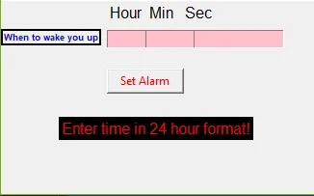

Slide 15
Hardware/Software Requirements
HARDWARE :
1.Processor –i3 or above
2.Hard Disk -4 GB or above
3.Android device or Window
SOFTWARE :
1.window 10 or Android
2.Google APIs(level 10 or higher)
3.PYTHON
4.Pycharm

Slide 16
conclusion
Overall, we met almost all of our expectation and stuck to the design plan we initially set up.we achieved a working and accurate clock that had an alarm that would go off at the set time or a time signaled by the sleep cycle system . The alarm would produce a very obnoxious noise that would force the person to get up.
The display alarm clock was nice and clean cut and had simple and easy control.It even lets you set your music as an alarm so you wake up to your favourite tunes.

Slide 17
Project work remaining
1. Alarm clocks use sensing technology such as EEG electrodes and accelerometers to wake people from sleep.
2.Drawn simulator are another technology meant to mediate these effects.
3.Sleepers can became accustomed to the sound of their alarm clock if it has been used for period of time , making it less effective.
4.The deaf and hard of hearing are often unable to perceive auditory alarm when asleep.
5.They may use specialized alarms,including alarms with flashing light instead of or in additition to noise .

Slide 18
6.Alarm which can connect to vibrating device (small ones inserted into pilows,or larger ones placed under bedposts to shake the bed)also exist.
7.Time switches can be used to turn on anythying that will awaken a sleeper ,and can therfore be used as alarm .
8.Sleepers can become accustomed to the sound of their alarm clock if it has been used for a period of time ,making it less effective.
9.Simple alarm clocks make a loud buzzing or beeping sound to wake a sleeper,while novelty alarm clocks can speak ,sing,or play sound from nature.
10.A progressive alarm clock, can have different alarms for different times and music of the user’s choice.

Slide 19
PUBLICATION
1.Use our core python book Dr.R Nageswara Rao.
2.Use Fluent python ,think python,python cookbook and official python tutorial.
3.www.python.org is using.
4.www.tcl.tk.is using.
5.Using pycharm for making after installing.

Slide 20
REFERENCES
1.Marry Bellis “History of clock” Retrived 2 november 2006.
2.Reuven Fenton (29 August 2007).”Bio-alarm clocks set for perfect wake –up” Reuters.Retrived 9 june 2008
3.”Best coffee makers, cool,Alarm clock Technology”.
4.Alerting devices for the hearing impaired .
5.Vibrating alarm clocks to help deaf children wake up, NDCS.org.uk.

Slide 21
THANK YOU

